Slide 1
Self-Supervised learning for Conversational Recommendation
SSCR

Slide 2



Overview
Recommender Module
Dialogue generation Module
fine-tuning stage
pre-training stage
Knowledge-aware
Generator
pre-training stage
the parameters of recommender module (including GCN, RGCN and self-attention parameters ) are optimized by:
Initialize the parameters learned from pre-training stage and train the entire recommendation parameters with the help of the supervised signals:
is leveraged to pre-train the embedding layers Emb𝑐, Emb𝑟 and transformation matrix 𝑊𝑐

Slide 3
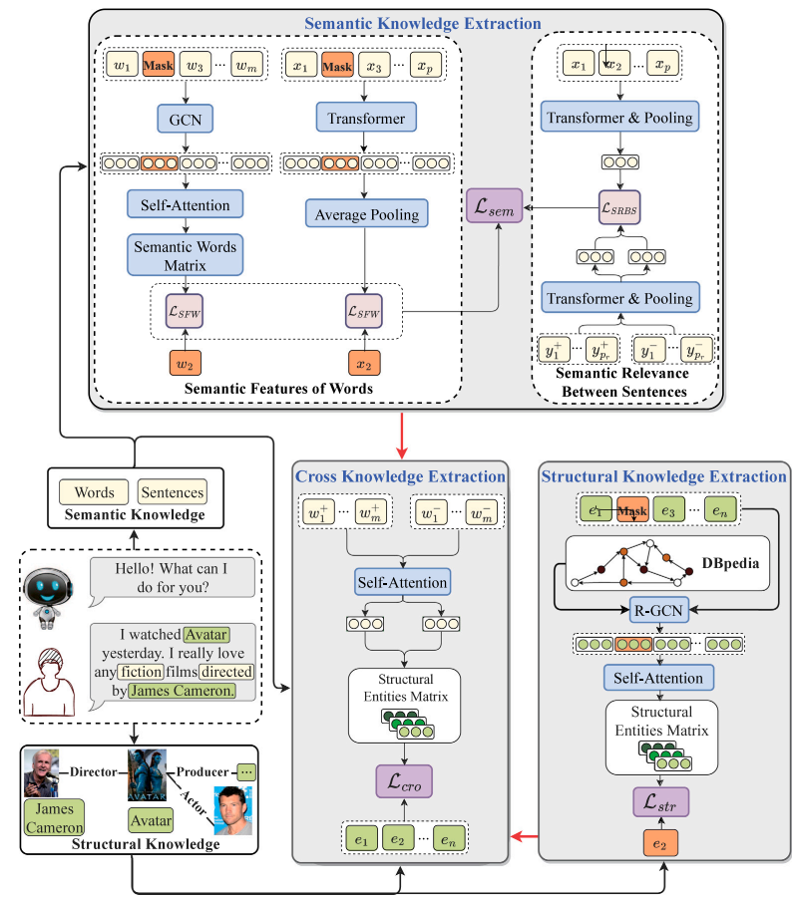
Recommender Module & Dialogue generation Module
pretraining stage:
Semantic Knowledge Extraction
Structural Knowledge Extraction
Cross knowledge extraction

Slide 4
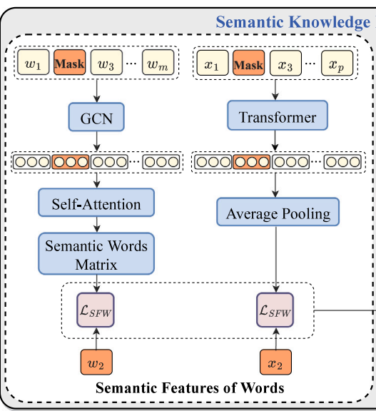

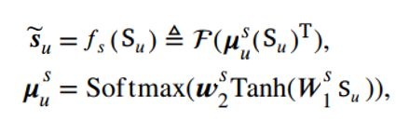



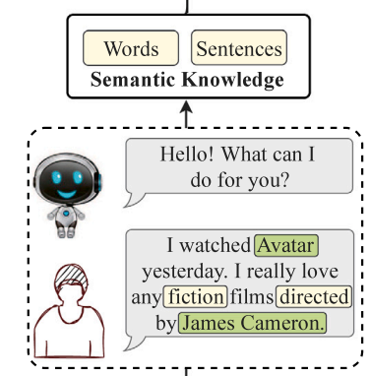

Semantic Knowledge Extraction
Words Semantic Task for Dialogue
Main idea:encourage model to be aware of the semantic features and semantic connections among words
Words Semantic Task for Recommendation
Main idea:discriminate the target word given the surrounding context words
ConceptNet

Slide 5
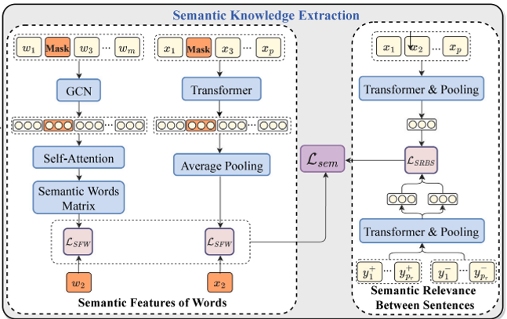





Semantic Knowledge Extraction
Modelling semantic relevance between sentences:
Main idea:force the model to distinguish whether the context–response pairs are from the same dialogue. ex.

Slide 6
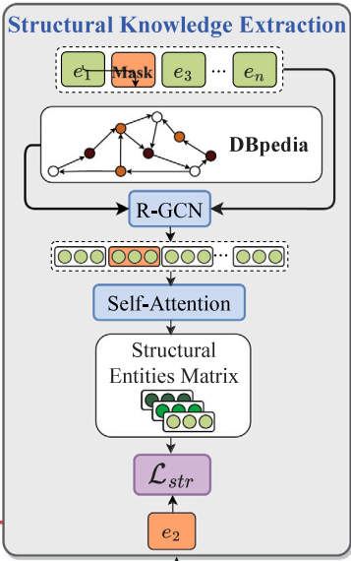

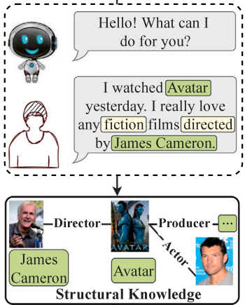





Structural Knowledge Extraction
Main idea:explore the intrinsic correlations of user mentioned entities on knowledge graphs for the recommender module

Slide 7
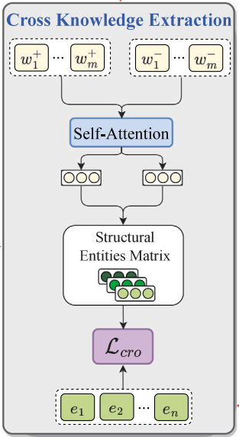






Cross knowledge extraction
Main idea:we would like to exploit the inter-information between semantic words and structural entities.Our goal is to minimize the difference between entities set and positive words, and maximize that between entities set and negative words.

Slide 8







Recommender Module : fine-tuning stage
leverage the gate mechanism to fuse the two parts:
(T denotes the structural matrix that includes the representations of all entities.)

Slide 9
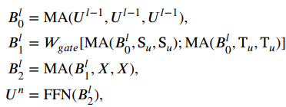


Dialogue generation Module :
Knowledge-aware Generator
Transformer Decoder:

